Slide 1
학습 문제 해결방안

Slide 2
1. 학습 유형 변경 to Unsupervised learning
Unsupervised machine learning techniques do not require labeled training data.
For the application of machine learning to facility level safeguards, unsupervised techniques must be used.
With unsupervised methods only normal data and few, if any, misuse cases are used to train the models.
The use of unsupervised methods eliminates the burden of identifying all possible diversion pathways.

Slide 3
2. Algorithm 변경 (제안)
SVM in time series data
데이터가 너무 적어서 NN이 불가능하다면, algorithm을 바꾸는 것은?
이럴 경우 Feature 추출 문제가 있는 것으로 암

Slide 4
3. Feature (input data) 확장 방안
Experiment condition 추가
Current (100 to 500 mA in 50 mA interval) – fixed value
이론에 입각한 인위적 계산 데이터 추가
Surface area (Appendix 1 참조)
Data 추가
2017년 실험한 데이터 사용 (온도변화 실험도 수행함) – 찾아야 함.
Preprocessing 추가 작업
Smoothing: savitzky-Golay filter, moving average 등 (Appendix 2 참조)
신호 증폭 (비례적으로 커지면 의미없으려나) 또는 간섭 (Constructive or destructive interference_{상쇄간섭})
시간에 따라 구간 설정해서 input 나누기 (운전시간 = surface area의 간접적 indicator)
Ex. 초기(공전착이 주로 일어나는)이 후, 수초 단위로 데이터를 나누어 학습?

Slide 5
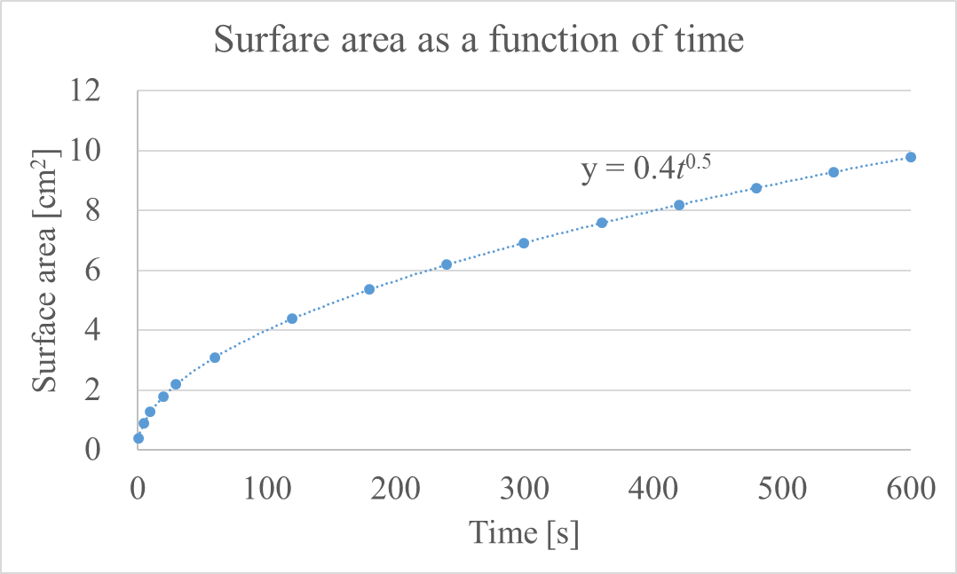
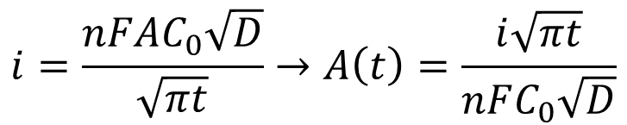
Appendix 1. The cathode surface area is able be estimated based on the Cottrell equation
Cottrell equation:
Experiment condition:
Constant current: i
Concentration is ~10 wt of LnCl₃
Ex. When applied current is 0.1 A
$$i=\frac{nFAC_{0}\sqrt{D}}{\sqrt{πt}}→A\left(t\right)=\frac{i\sqrt{πt}}{nFC_{0}\sqrt{D}}$$
Notes:
The purpose of Cottrell equation is to describe the current change with time as a response of controlled potential.
However, in this study, since the current is constantly supplied for given time,
the equation is converted to regarding electrode area (A) as a function of time
and the average value is calculated by integrating the obtained equation and dividing it with total time.
Though, Still the dynamic change of surface area can’t be presented with this approach.
Comparing the initial approach (which shown in the last presentation), this way makes sense more.

Slide 6
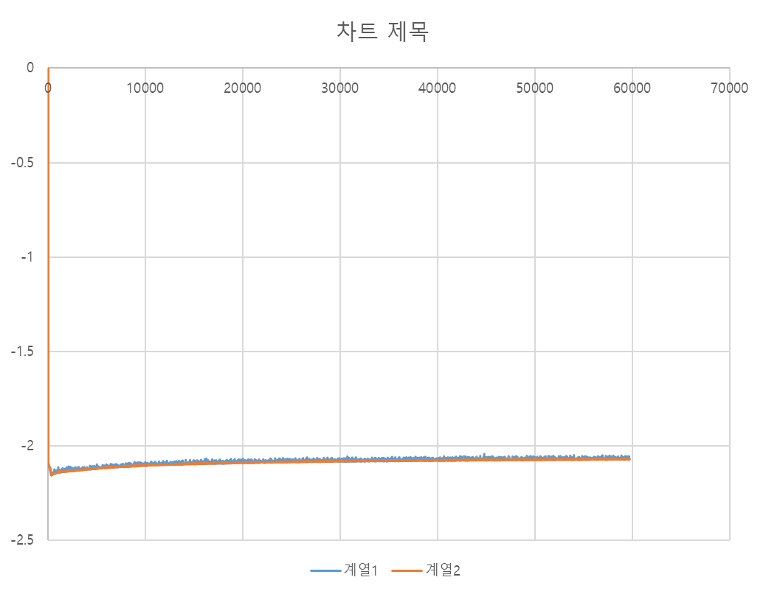
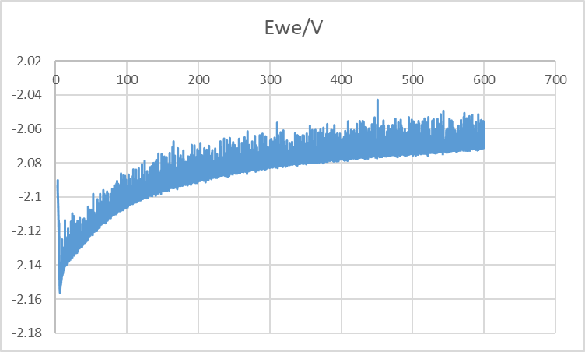
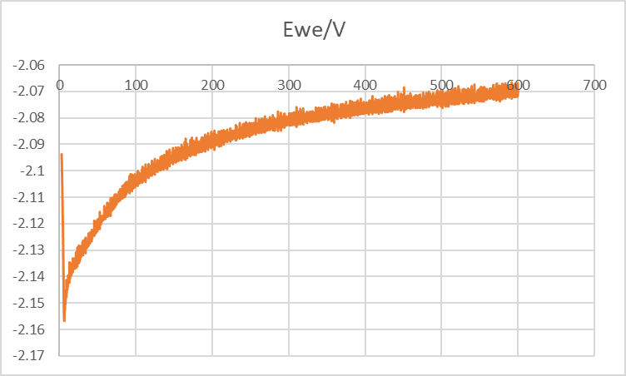
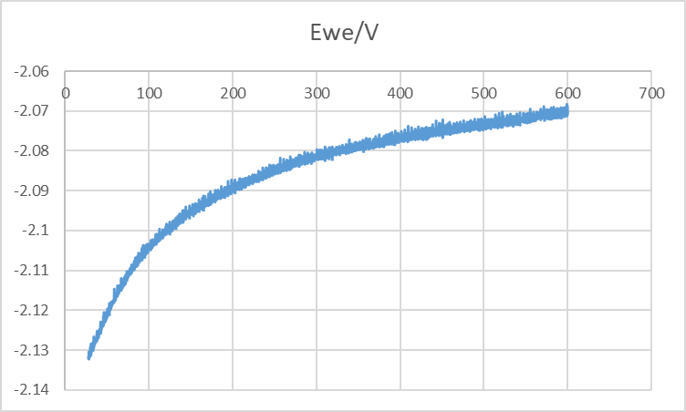
Appendix 2. smoothing data
Hertz를 줄인 데이터를 사용하면 필터링 효과과 더 확연할 것.
No filtering
savitzky-Golay filtering – windon size: 11
savitzky-Golay filtering – windon size: 27

